Slide 1

Chapter 2
THIRD EDITION
ECONOMICS
and
MICROECONOMICS Paul Krugman | Robin Wells
Economic Models: Trade-offs and Trades

Slide 2

An Introduction to Economic Thinking
What we will look at today:
Why models—simplified representations of reality—play a crucial role in economics
Two simple but important models: the production possibility frontier and comparative advantage
The circular-flow diagram, a schematic representation of the economy
The difference between positive economics and normative economics
When economists agree and why they sometimes disagree

Slide 3
Models in Economics
A model is a simplified representation of a real situation that is used to better understand real-life situations. How? By
Creating a real but simplified economy
Example: cigarettes in World War II prison camps
Simulating an economy on a computer
Examples: tax models, money models…
When using models, we try to treat economics as close to experimental science as possible—only one variable allowed to change at a time
The “other things equal” assumption means that all other relevant factors remain unchanged

Slide 4

Models in Economics
Just like a map is a simplified representation of the world that is used to better understand geography,
A model is a simplified representation of a situation that is used to better understand a real-world issue.

Slide 5
Trade-offs: The Production Possibility Frontier
The production possibility frontier (PPF) is a simple model about what a society can produce
The production possibility frontier (PPF) illustrates the trade-offs facing an economy that produces only two goods.
It shows the maximum quantity of one good that can be produced for any given production of the other good.
The PPF improves our understanding of trade-offs by considering a simplified economy that produces only two goods by showing this trade-off graphically.

Slide 6
The Production Possibility Frontier
Quantity of Dreamliners
30
D
Feasible and
efficient
in production
Not feasible
A
15
Societal
choice
Feasible but not efficient
B
9
C
Production possibility frontier
PPF
0
20
28
40
Quantity of small jets
Notes:
Figure Caption:
Figure 2.1 - The Production Possibility Frontier
The production possibility frontier illustrates the trade-offs facing an economy that produces two goods. It shows the maximum quantity of one good that can be produced given the quantity of the other good produced. Here, the maximum quantity of Dreamliners that Boeing can produce depends on the quantity of small jets that Boeing can manufacture, and vice versa. His feasible production is shown by the area inside or on the curve. Production at point C is feasible but not efficient. Points A and B are feasible and efficient in production, but point D is not feasible.

Slide 7
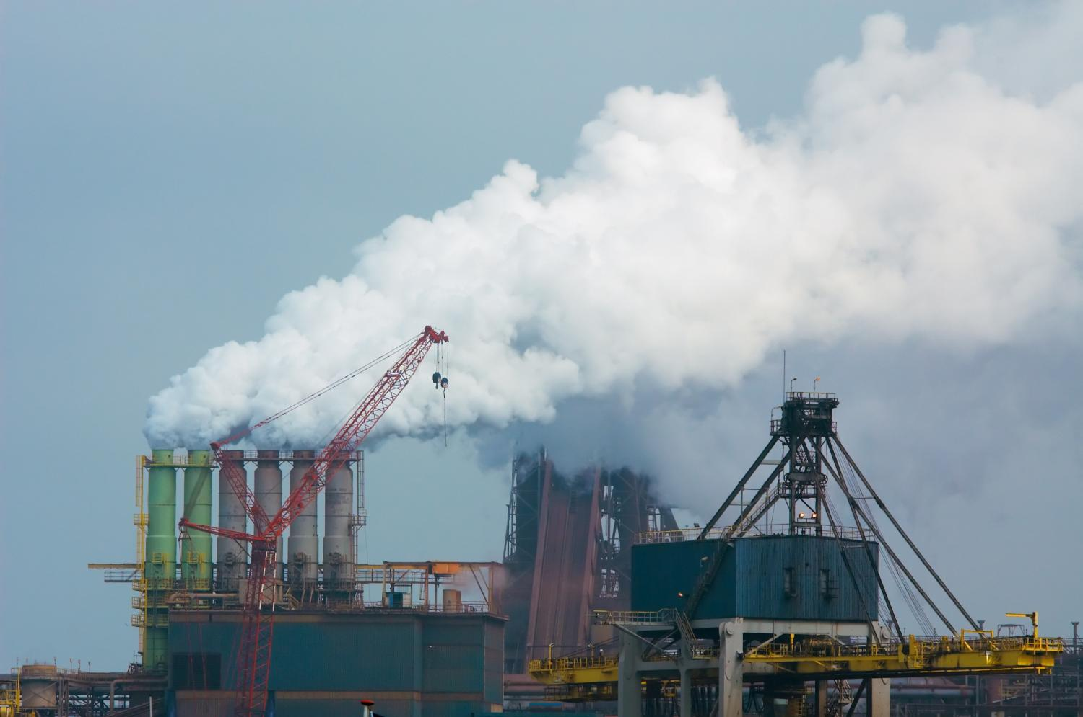
Trade-offs: The Production Possibility Frontier
The PPF model answers questions like:
How much can we produce?
What will it cost us to increase production of a certain good?
Does it make sense to import the good from somewhere else?

Slide 8
Opportunity Cost
Opportunity Cost: what must be given up in order to get a good.
Each small jet has an opportunity cost of
3/4 of a Dreamliner.
Production Possibilities
Dreamliners | Small Jets
30 | 0
15 | 20
14.25 | 21
13.5 | 22
12.75 | 23
12 | 24
9 | 28
0 | 40
Each Dreamliner has an opportunity cost of
1 1/3 of a small jet.
7

Slide 9
Increasing Opportunity Cost
As quantity produced of a good grows large, the opportunity cost of producing one more unit increases.
This happens because less and less suitable resources are reallocated to produce that one good
Quantity of Dreamliners
Producing the first
20 small jets . . .
…requires giving up
5 Dreamliners.
35
30
But producing
20 more small jets . . .
A
25
20
15
…requires giving up
25 more Dreamliners.
10
5
PPF
0
10
20
30
40
50
Quantity of small jets
Notes:
Figure Caption:
Figure 2.2 - Increasing Opportunity Cost
The bowed-out shape of the production possibility frontier reflects increasing opportunity cost. In this example, to produce the first 20 small jets, Boeing must give up 5 Dreamliners. But to produce an additional 20 small jets, he must give up 25 more Dreamliners.

Slide 10
Economic Growth
Quantity of Dreamliners
Economic growth results in an outward shift of the PPF because production possibilities are expanded.
35
E
30
A
25
The economy can now produce more of everything.
20
15
10
5
Original
New
PPF
PPF
0
10
20
25
30
40
50
Quantity of small jets
Notes:
Figure 2.3 - Economic Growth
Economic growth results in an outward shift of the production possibility frontier because production possibilities are expanded. The economy can now produce more of everything. For example, if production is initially at point A (20 small jets and 25 Dreamliners), it could move to point E (25 small jets and 30 Dreamliners).

Slide 11
Production Possibilities for Two Countries
U.S. Production and Consumption Possibilities without trade
Quantity of large jets
30
U.S. consumption
without trade
18
U.S.
PPF
0
16
40
Quantity of small jets
Notes:
Figure Caption:
Figure 2.4 - Production Possibilities for Two Countries
Here, each of the two countries has a constant opportunity cost of small jets and a straight-line production possibility frontier. In the U.S.’s case, each small jet always has an opportunity cost of 3⁄4 of a large jet.

Slide 12
Production Possibilities for Two Countries
Brazilian Production and Consumption Possibilities without trade
Quantity of large jets
Brazil consumption
without trade
10
8
Brazil
PPF
0
6
30
Quantity of small jets
Notes:
Figure Caption:
Figure 2.4 - Production Possibilities for Two Countries
Here, each of the two countries has a constant opportunity cost of small jets and a straight-line production possibility frontier. In Brazil’s case, each small jet always has an opportunity cost of 1/3 of a large jet.

Slide 13
United States and Brazilian Opportunity Costs
 | U.S. Opportunity Cost |  | Brazilian Opportunity Cost
One small jet | 3/4 large jet | > | 1/3 large jet
One large jet | 4/3 small jets | < | 3 small jets
Notes:
TABLE 2-1

Slide 14
Specialize and Trade
A country has a comparative advantage in producing goods for which it has the lowest opportunity cost.
Both countries are better off when they each specialize in what they are good at and then trade.
It’s a good idea for Brazil to make the small jets for both of them, because its opportunity cost of a small jet in terms of large jet not made is only 1/3 of a large jet, versus 3/4 large jets for the United States.
Correspondingly, it’s a good idea for the United States to make large jets for both of the countries.

Slide 15
Comparative Advantage and Gains from Trade
(a) U.S. Production and Consumption
(b) Brazilian Production and Consumption
Quantity of large jets
Quantity of large jets
U.S. production with trade
30
U.S. consumption without trade
Brazilian consumption with trade
U.S. consumption with trade
Brazilian consumption without trade
20
10
18
8
Brazilian production with trade
U.S.
Brazilian
PPF
PPF
0
16
20
40
Quantity of small
jets
0
6
10
30
Quantity of small
jets
Notes:
Figure Caption:
Figure 2-5: Comparative Advantage and Gains from Trade
By specializing and trading, the two countries can produce and consume more of both goods. Brazil specializes in making small jets, its comparative advantage, and US specializes in making large jets. The result is that each country can consume more of both goods than either could without trade.

Slide 16
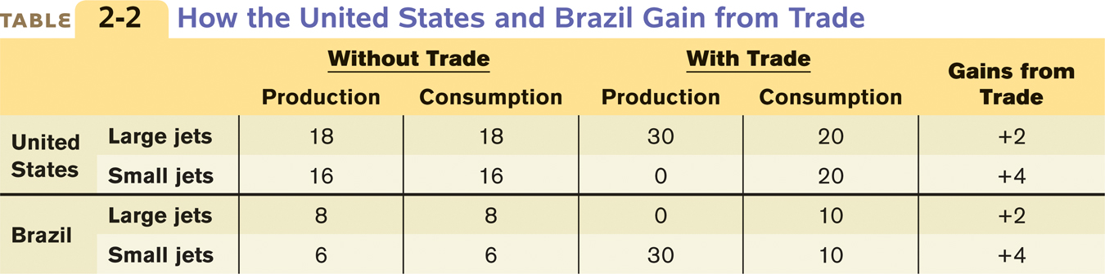
How the Two Countries Gain from Trade
Both the United States and Brazil experience gains from trade:
U.S. consumption of large jets increases by two, and its consumption of small jets increases by four.
Brazilian consumption of large jets increases by two, and his consumption of small jets increases by four.
The US has a comparative advantage in producing large jets, and a comparative disadvantage in producing small jets

Slide 17

Comparative vs. Absolute Advantage
Don’t confuse absolute and comparative advantage
An individual has an absolute advantage in an activity if he or she can do it better than other people.
An individual has a comparative advantage if the opportunity cost of producing the good is lower for that individual than for other people.
Just because the United States can produce more of both goods doesn’t mean we’re better off without trade.
Pay attention to opportunity costs: Since it’s cheaper for Brazil to produce small jets the United States will benefit from importing small jets from Brazil.

Slide 18

Practice: Check Your Understanding
Suppose that in Australia, it takes a worker 2 hours to harvest 10 kilos of apples and 4 hours to harvest 10 kilos of tomatoes. Suppose a worker in Brazil can harvest 10 kilos of apples in 4 hours or 10 kilos of tomatoes in 5 hours. Which of these statements is TRUE?
Brazil has a comparative advantage in producing tomatoes.
Brazil has a comparative advantage in producing apples.
Brazil has an absolute advantage in producing both goods.
In trade between these two countries, Australia would gain and Brazil would lose.

Slide 19
Suppose that in Australia, it takes 2 hours to harvest 10 bushels of apples and 4 hours to harvest 10 bushels of tomatoes. Suppose a worker in Brazil can harvest 10 bushels of apples in 4 hours or 10 bushels of tomatoes in 5 hours. Which of these statements is TRUE?
Brazil has a comparative advantage in producing tomatoes.
Brazil has a comparative advantage in producing apples.
Brazil has an absolute advantage in producing both goods.
In trade between these two countries, Australia would gain and Brazil would lose.
Notes:
This a more difficult question because it requires a two-step calculation of cost. A is correct. In Australia, the opportunity cost of harvesting 10 bushels of tomatoes is 20 bushels of apples. In Brazil, the opportunity cost of harvesting 10 bushels of tomatoes is 12.5 bushels of apples. Australia has the absolute advantage in both goods, but also exhibits the higher opportunity cost of growing tomatoes.

Slide 20




Transactions: The Circular-Flow Diagram
Production and trade in an economy can be represented by the circular-flow diagram:
Money
Money
Goods and services
Factors
Trade in physical things such as goods, services, labor, and raw materials flows in one direction…
…and the money that pays for these physical things flows in the opposite direction.
Goods and services
Factors
Money
Money

Slide 21
Circular-Flow of Economic Activities
A household is a person or a group of people that share their income.
A firm is an organization that produces goods and services for sale.
Firms sell goods and services that they produce to households in markets for goods and services.
Firms buy the resources they need to produce goods and services—factors of production—in factor markets.
The factor markets determine how the economy’s income is distributed — how production is divided among the owners of the various factors of production.

Slide 22
FIGURE 1: The Circular-Flow Diagram
Households:
Own the factors of production
Rent them to firms for income
Use income to buy and consume goods and services
Firms:
Hire factors of production
Use them to produce goods & services
sell goods & services to get money to pay households
Notes:
This and the following two slides build the Circular-Flow Diagram, piece by piece.

Slide 23
Using Models
Positive economics is the branch of economic analysis that describes the way the economy actually works.
A forecast is a simple prediction of the future, and is part of positive economics.
E.g. If the government increases taxes in this market, the quantity produced will fall.
Normative economics makes prescriptions about the way the economy should work.
E.g. The government should care of environmental degradation, as much as it cares about economic growth.
Economists can determine correct answers for positive questions, but usually not for normative questions, which involve value judgments.

Slide 24
Label each of the following statements as positive (a) or normative (b):
More than 60% of women are in the labor market.
Rent control laws should be implemented because they help to achieve equity or fairness in housing.
Society should take measures to end gun violence.
People who smoke pass on increased medical costs to the whole society.
Single mothers are more than twice as likely as married mothers to be in poverty.
Notes:
1. A 2. B 3. B 4. A 5. A

Slide 25
Using Models: When and Why Economists Disagree
Newspapers tends to exaggerate the differences in views among economists
Economic modeling requires simplifying assumptions
Two economists can legitimately disagree about which models and which simplifications are appropriate.
In most cases such disputes are eventually resolved (although it can take a long time)
Economists can also disagree about values
Economists may disagree about which is more important: income inequality or income growth
Economics is often tied up in politics
Powerful interest groups find and promote economists who give supportive opinions.

Slide 26
SUMMARY
Almost all economics is based on models. An important assumption in economic models is the other things equal assumption, which allows analysis of the effect of a change in one factor by holding all other relevant factors unchanged.
One important economic model is the production possibility frontier. It illustrates: opportunity cost, efficiency, and economic growth. There are two basic sources of growth: an increase in factors of production — resources such as land, labor, capital, and human capital, inputs that are not used up in production — and improved technology.

Slide 27
SUMMARY
Another important model is comparative advantage, which explains the source of gains from trade between individuals and countries. Everyone has a comparative advantage in something. This is often confused with absolute advantage, an ability to produce a particular good or service better than anyone else.
In the simplest economies, people barter or trade goods and services for one another—rather than trade them for money, as in a modern economy. The circular-flow diagram represents transactions within the economy as flows of goods, services, and money between households and firms. These transactions occur in markets for goods and services and factor markets.

Slide 28
SUMMARY
Economists use economic models both for positive economics, which describes how the economy works, and for normative economics, which prescribes how the economy should work. Positive economics often involves making forecasts. Economists can determine correct answers for positive questions, but typically not for normative questions, which involve value judgments.
There are two main reasons economists disagree. One: they may disagree about which simplifications to make in a model. Two: economists may disagree—like everyone else—about values.

Slide 29
KEY TERMS
Model
Other things equal assumption
Production possibility frontier
Factors of production
Technology
Comparative advantage
Absolute advantage
Barter
Circular-flow diagram
Household
Firm
Markets for goods and services
Factor markets
Income distribution
Positive economics
Normative economics
Forecast
Specialization
Equilibrium
Efficient
Equity

